Slide 1
CELL

Slide 2
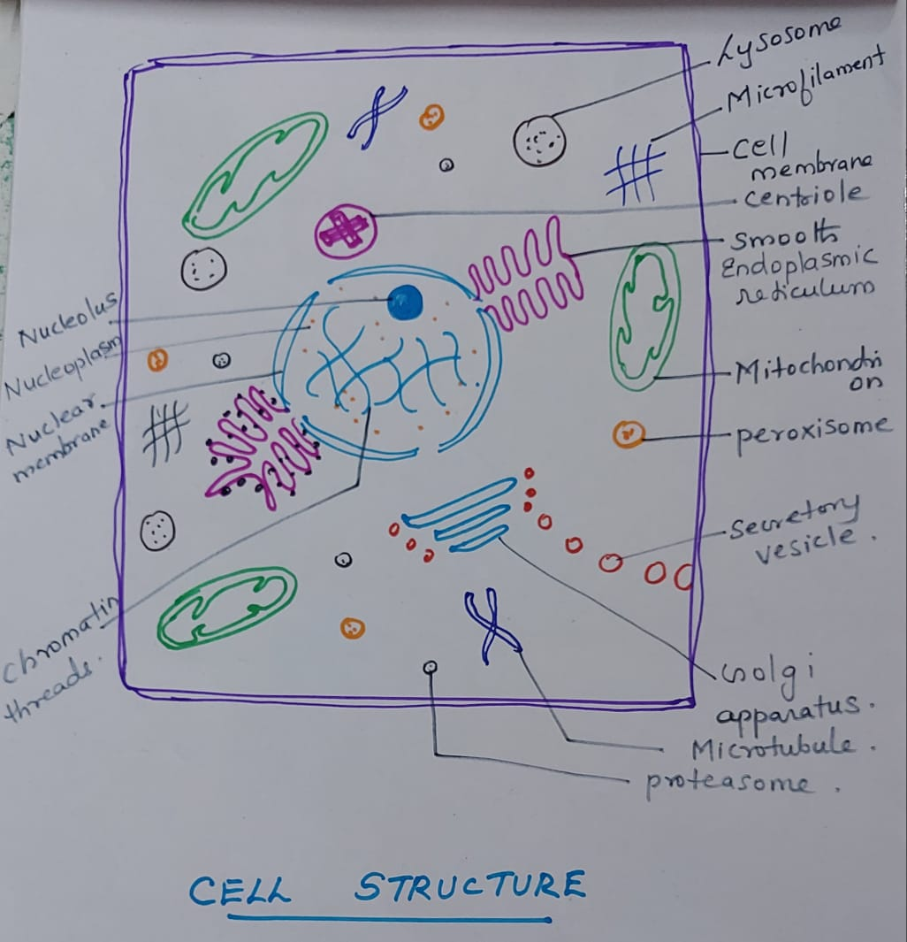
STRUCTURE OF CELL

Slide 3
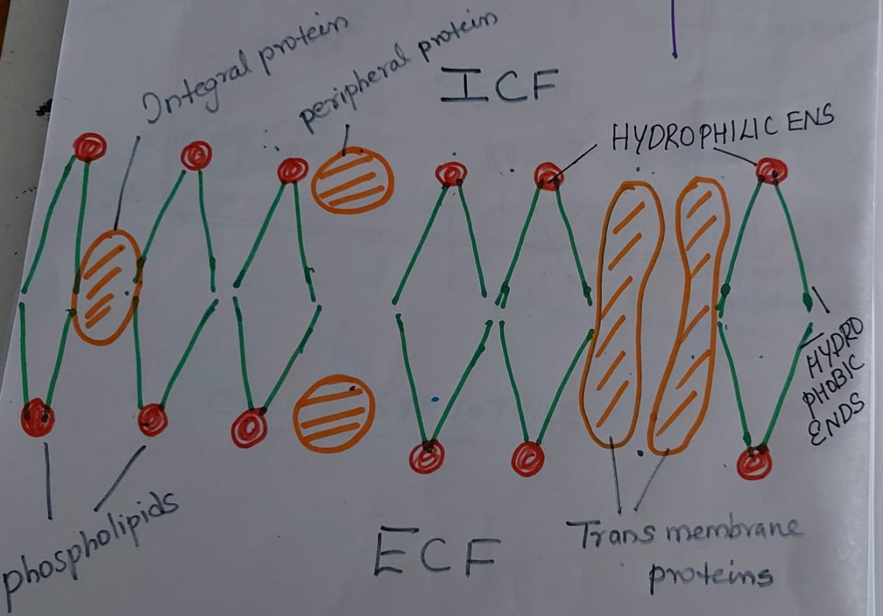
STRUCTURE OF CELL MEMBRANE

Slide 4
STRUCTURE OF CELL MEMBRANE
Cell membrane is made up of two layers of phospholipids.
Each phospholipid has a hydrophilic end and a hydrophobic end.
Hydrophilic ends face towards ICF OR ECF, while the hydrophobic ends face towards each other.
In between the phospholipids are the protein molecules.
There are three types of protein molecules.
1. Peripheral proteins
2. Integral proteins
3. Trans membrane proteins.
Attached to proteins and lipids are the glycogen molecules.

Slide 5
FUNCTIONS OF CELL MEMBANE
1.Help to maintain the normal shape of a cell.
2.Help in different types of transport like osmosis, diffusion, active transport etc.
3.Peripheral proteins can act as enzymes, cell adhesion molecule, cell identity markers, antigens etc.
4. Trans membrane proteins help in the formation of channel proteins. There are two types of channels like Gated and Ungated channels.
5. Some cell membrane proteins act as pumps[sodium-potassium pump], aquaporins, carrier proteins etc.

Slide 6
MITOCHONDRIA
Is the power house of the cell
Is double layered , outer layer is smooth while inner layer is invaginated into infoldings or cristae.
Cavity of mitochondria is filled with matrix
Attached to the cristae and present in the matrix are enzymes which help in cellular respiration and help in ATP synthesis.
Mitochondrial DNA help in self replication.
Mitochondrial DNA is inherited from mother.
Shape of mitochondria varies ie spherical, filamentous, sausage shaped etc.

Slide 7
ENDOPLASMIC RETICULUM
Is a system of membrane enclosed channels called cisternae.
Is continuous with the nuclear membrane.
There are two types
1. Rough Endoplasmic Reticulum
2. Smooth Endoplasmic Reticulum
Rough endoplasmic reticulum help in protein synthesis.
Smooth endoplasmic reticulum help in synthesis of fatty acids , phospholipids, steroids etc.
In skeletal and cardiac muscle, smooth endoplasmic reticulum help in storage of calcium and calcium is released during muscle contraction.

Slide 8
GOLGI APPARATUS
Golgi apparatus help in secretory activity.
Consists of flattened sacs or cisterns and vesicles
It process, pack and release proteins and lipids to the cell membrane and also form lysosomes and secretory vesicles.
Also synthesize substances like mucopolysaccharide.

Slide 9
LYSOSOME
Is the suicidal bag of the cell
There are 40 different lysosomal enzymes.
Enzymes help to digest proteins, lipids and carbohydrates.
Can digest other cell organelles by AUTOPHAGY.
Can digest the whole cell by AUTOLYSIS.
Neutrophil, Eosinophil and Basophil granules are lysosomes.

Slide 10
PEROXISOME
Is formed from Endoplasmic reticulum
Contain 50 different metabolic enzymes that oxidize organic substances and produce H₂O₂.
An enzyme catalase make use of H₂O₂ to detoxify toxins like phenol, formic acid, formaldehyde etc. in Liver and Kidney.

Slide 11
PROTEASOME
Are tiny vesicles present in the cell.
It stores proteases which can destruct abnormal proteins formed in a cell.
It can degrade metabolic enzymes after their normal function.
Each cell has thousands of proteasomes which can split proteins into peptides and then into amino acids.

Slide 12
CENTROSOME
Consist of a pair of centriole
Also called microtubular organizing center
Help in cell division. centrosome divide and move apart to form the poles of mitotic spindle.

Slide 13
MICROFILAMENT AND MICROTUBULE
MICROFILAMENTS
Made up of F-Actin strands which are coiled.
Help in movement of the cell, cell division, muscle contraction etc.
MICROTUBULES
Are unbranched hollow tubes made up of tubulin.
Help to maintain cell shape and also help in movement of vesicles.

Slide 14
NUCLEUS
Nucleus is bounded by nuclear membrane. Nuclear pores present in the membrane help in the movement of mRNA. Fluid present inside the nucleus is nucleoplasm. Nucleolus is present in the nucleoplasm and is the site of rRNA synthesis and ribosomes
chromosomes help in transfer of hereditary material from one cell generation to the next cell generation. It help in protein synthesis by the process of transcription and translation.
Functional proteins help to perform the normal function of a cell.

Slide 15
TYPES OF TRANSPORT
DIFFUSION
Is the movement of substances from greater concentration to lesser concentration through the cell membrane. There are two types
1.SIMPLE DIFFUSION
2.FACILITATED DIFFUSION
SIMPLE DIFFUSION
Is the movement of lipid soluble substances from a region of higher concentration to a region of lower concentration.
Examples__ O₂, CO₂, N ₂, Urea, water etc.
FACILITATED DIFFUSION
Is the movement of lipid insoluble subtances from a region of higher concentration to a region of lower concentration with the help of a carrier protein.
Example_ Absorption /Reabsorption of glucose / amino acid.

Slide 16
FACTORS AFFECTING DIFFUSION
1.DISTANCE– Greater the distance ,longer the time taken for diffusion.
2. SIZE OF GRADIENT– Larger the concentration gradient, greater the rate of diffusion
3.TEMPERATURE—Higher the temperature ,faster the rate of diffusion
4.MOLECULAR WEIGHT—Increase in molecular weight ,decrease the permeability.
5.LIPID SOLUBILITY--- Lipid soluble substances diffuse rapidly.
6.SURFACE AREA---Larger the surface area. Faster the diffusion.

Slide 17
ACTIVE TRANSPORT
Is the movement of a substance from a region of lower concentration to a region of higher concentration with the help of a carrier protein and energy. There are two types
PRIMARY ACTIVE TRANSPORT
SECONDARY ACTIVE TRANSPORT
PRIMARY ACTIVE TRANSPORT
Is the movement of a substance from lower to higher concentration with the help of ATP and a carrier protein called pump. In primary active transport the carrier protein which can break ATP is called ATPase.
Example __ Nа⁺ ₋ K⁺ pump, H⁺₋ K⁺ pump, Na⁺₋ H⁺ PUMP etc.

Slide 18
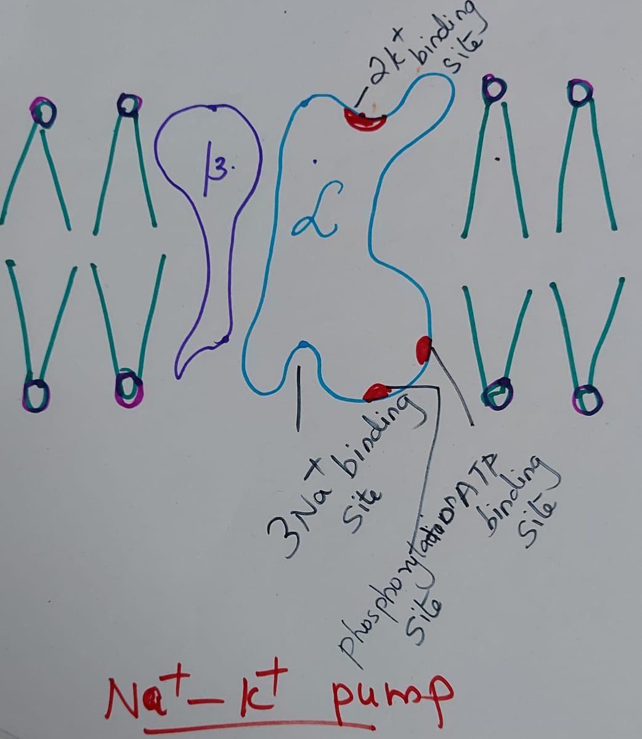
Na⁺₋ K⁺ PUMP

Slide 19
SODIUM- POTASSIUM PUMP/Na⁺₋ K⁺ PUMP
Has two subunits, α andβ subunits. α subunit has intracellular Na⁺ and ATP binding site and a phosphorylation site. It also has an extracellular K⁺ binding site. When activated three Na⁺ bind to Na binding site , ATP bind to ATP binding site and two K⁺ bind to k binding site. ATP is hydrolyzed to ADP and energy is released. This cause a change in the configuration of protein and three Na⁺ are extruded into ECF and two K⁺ are intruded into the cytoplasm.
When the intracellular sodium concentration become high this pump get activated and help to maintain the normal cell size.

Slide 20
SECONDARY ACTIVE TRASPORT
Is the transport of a substance from lower to higher concentration with the help of energy stored in the concentration difference of another substance.
Example - Transport of glucose /amino acid along with sodium.
Secondary active transport is a combination of primary active transport and facilitated diffusion. Since two substances are transported with the help of a single carrier protein this transport is also called symport/Co-transport.

Slide 21
OSMOSIS
Is the movement of water molecules from a region of its higher concentration to a region of its lower concentration.
There are two types
1. ENDOSMOSIS
2.EXOSMOSIS
ENDOSMOSIS- Is the movement of water molecules from ECF to ICF.
EXOSMOSIS- Is the movement of water molecules from ICF to ECF.

Slide 22
ICF[INTRA CELLULAR FLUID] and ECF[EXTRA CELLULAR FLUID]
INTRA CELLULAR FLUID/ICF | EXTRA CELLULAR FLUID/ECF
Is the fluid present inside the cell also known as cytoplasm. It contain all cell organelles . Form 55% of total body water Chief ions present are K⁺&PO₄⁻ Cannot be directly measured [ICF=TBF-ECF] Form 33% of total bodyweight. Total ICF volume is 22 liters | Is the fluid present out side the cell. It include interstitial fluid, blood. lymph and trans cellular fluid. Cell organelles are absent. Form 45% of total body water. Chief ions are Na⁺& Cl⁻ Can be directly measured by indicator dilution method. Form 27% of total body weight. 6. Total ECF volume is 18 liters

Slide 23
RESTING MEMBRANE POTENTIAL/RMP
Is the potential difference just inner and outer of the cell membrane when the cell is at rest. Resting membrane potential is always negative ,which shows that cytoplasm is negatively charged in relation to the ECF.[Due to Na⁺_ K⁺ pump]
Examples__
RMP of skeletal muscle is -90 millivolt
RMP of cardiac muscle is -90 millivolt
RMP of neuron is -70 millivolt
RMP of RBC is -10 millivolt
RMP OF SMOOTH MUSCLE IS -50 to -60 millivolt.

Slide 24
TYPES OF TRANSPORT BASED ON DIRECTION
UNIPORT-
Is the movement of a substance with the help of a carrier protein
Example- Facilitated diffusion of glucose/ amino acid.
SYMPORT-
Is the movement of two substances in the same direction with the help of a single carrier protein . Example – cotransport of glucose/amino acid along with sodium.
ANTIPORT-
Is the movement of two substances in opposite directions with the help of a single carrier protein. Example - Na⁺₋ H⁺ antiport.

Slide 25
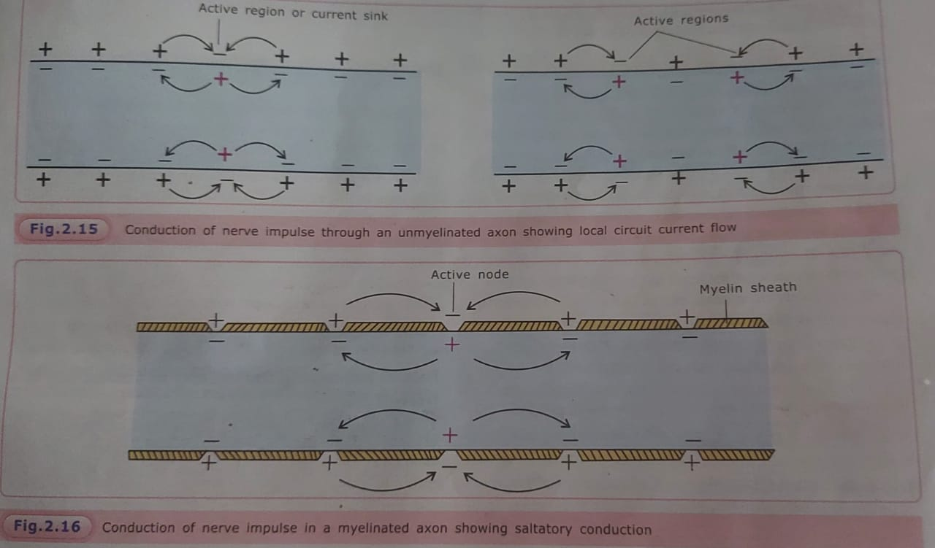

Slide 26
